Slide 1
Civil Rights Movement, 1954-1965
In 1954, the Civil Rights movement began with the Brown v BOE decision, but the rest of American society remained segregated:
The NAACP showed that the 14th Amendment could be used to challenge segregation
Civil rights leaders continued the fight for equality until segregation came to an end in 1965

Slide 2
The Montgomery Bus Boycott
In 1955, Rosa Parks’ arrest for disobeying an Alabama law requiring segregation on city buses sparked the Montgomery Bus Boycott
Minister Martin Luther King, Jr. organized a 381-day boycott of the bus system to protest segregation
The boycott led to the integration of city buses & to the rise of MLK as the leader of black civil rights

Slide 3
Martin Luther King, Jr.
The success of the Montgomery Bus Boycott led MLK to form the Southern Christian Leadership Conference (SCLC) in 1957:
The SCLC was formed to use activism & non-violent protest to bring an end to segregation
The SCLC soon overtook the NAACP as the leading civil rights group in America

Slide 4
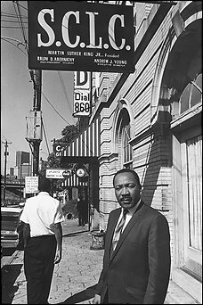
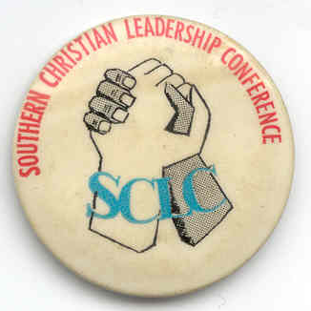
Martin Luther King & the SCLC
The SCLC was based on peaceful resistance & Christian love: “We will meet your physical force with soul force. We will not hate you, but we will not obey your evil laws. We will wear you down by pure capacity to suffer.”

Slide 5
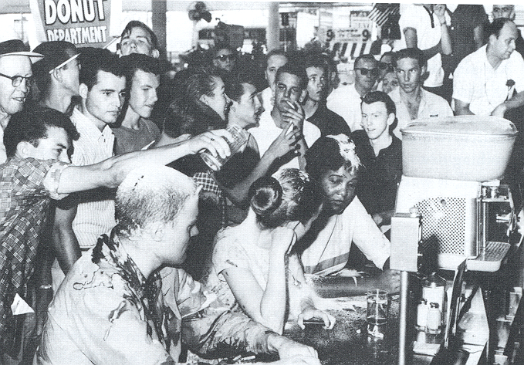
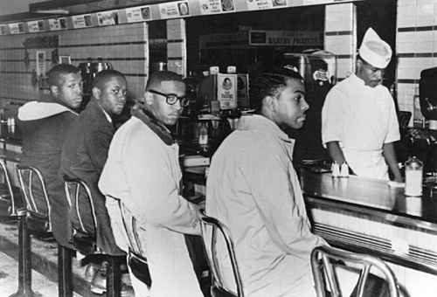
Activism Through Non-Violent Protest
Martin Luther King’s non-violent approach inspired other groups to act:
In 1960, students from NC A&T led a sit-in at a segregated lunch counter in Greensboro, NC
The “sit-in” movement led to the Student Nonviolent Coordinating Committee (SNCC)

Slide 6
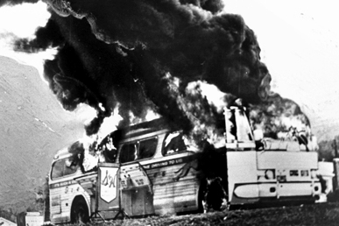
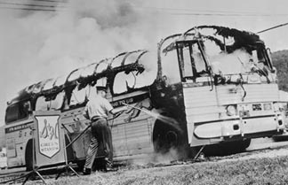
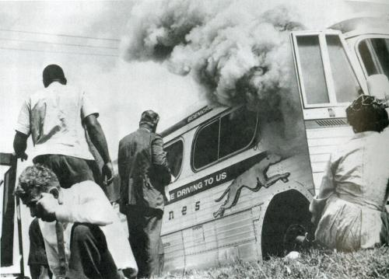
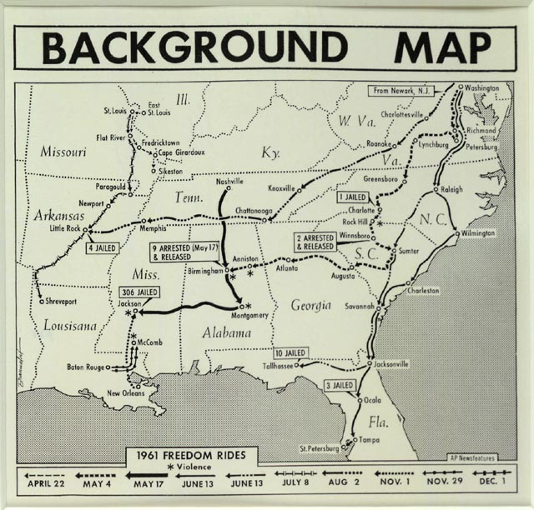
Activism Through Non-Violent Protest
Freedom riders faced arrest & violence but exposed the lack of enforcement of desegregation laws in the Deep South
In 1961 “Freedom Riders” rode buses throughout the South to test whether integration orders were being enforced
Martin Luther King’s non-violent approach inspired other groups to act:

Slide 7
March on Birmingham, 1963
In 1963, MLK organized a march to integrate Birmingham, Alabama
Birmingham was considered the “most segregated city in America”
MLK’s strategy was to confront segregation through peaceful marches, rallies, & boycotts
Birmingham Police commissioner Bull Connor used violence to suppress the demonstrations
Notes:
“the most segregated city in America”
Project C: The "C" in the project stood for confrontation, the strategy of nonviolent direct action designed to confront segregation through peaceful demonstrations, rallies, boycotts, and appeals to justice. This strategy actually hinged upon the anticipated reaction of Police Commissioner Bull Connor. Leaders reasoned that the response of Connor and the police would be to suppress the demonstrations, quite likely through violent means. If so, this response to peaceful protest would attract national attention and create public sympathy for the cause of desegregation.

Slide 8
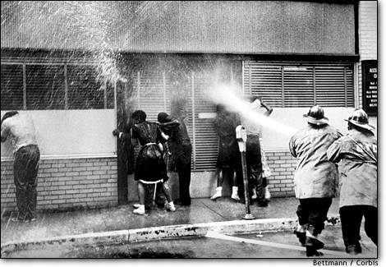
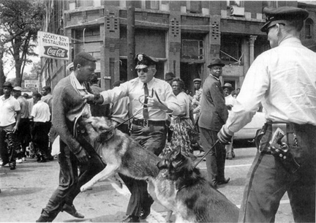
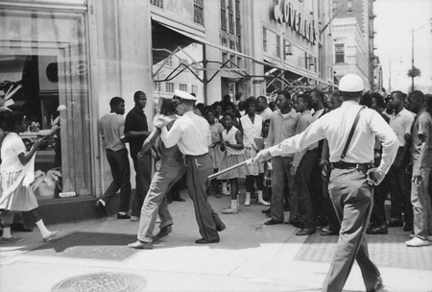
Violence in Birmingham, 1963

Slide 9
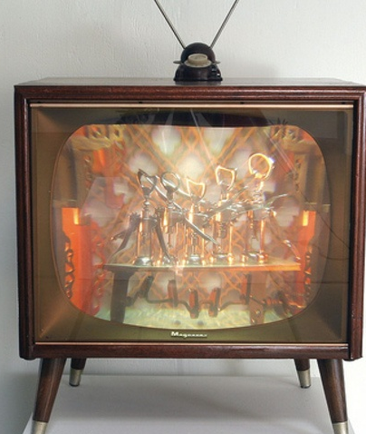
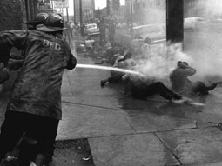
Violence in Birmingham, 1963
TV reports of the violence in Birmingham made it difficult for average Americans to ignore the plight of African Americans
Public outrage over police brutality forced Birmingham officials to end segregation

Slide 10
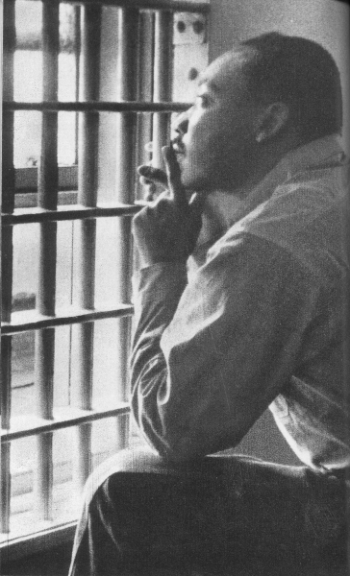
During the march in Birmingham, MLK was arrested
While in jail, MLK wrote an open letter called “Letter from a Birmingham Jail” in response to white leaders who believed King was pushing too fast towards civil rights
Read excerpts from Martin Luther King’s “Letter from a Birmingham Jail” & answer the discussion questions provided on the chart on the back of your notes

Slide 11
Read excerpts from King’s “Letter from a Birmingham Jail”

Slide 12
The Impact of Birmingham
The Birmingham march was a turning point in the Civil Rights movement:
The violence used by police revealed the need for gov’t action
TV broadcasted the events to a national audience

Slide 13
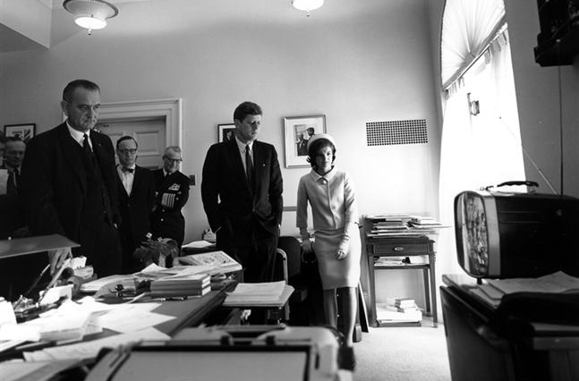
The Impact of Birmingham, 1963
Among those watching the violence on TV was President John F Kennedy who committed to a national civil rights act to end discrimination

Slide 14
March on Washington, 1963
In 1963, civil rights leaders led a March on Washington to pressure Congress to pass a civil rights bill
250,000 people assembled in Washington DC to hear speakers including MLK
Notes:
MLK delivered his “I Have a Dream” speech about a future without prejudice or segregation

Slide 15
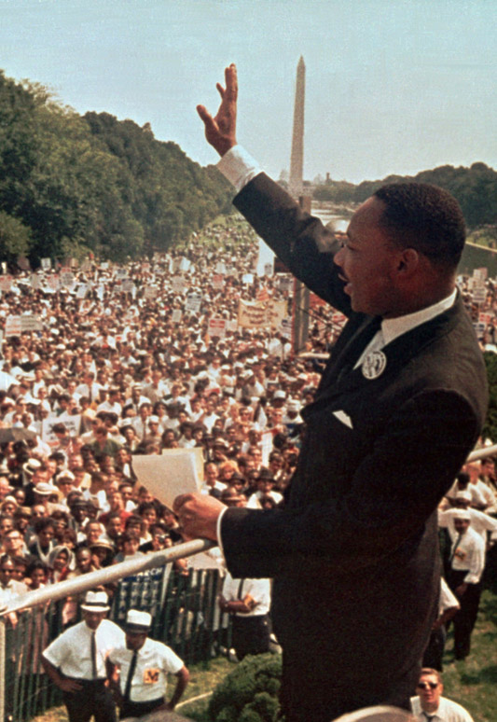
“I Have a Dream” Speech, 1963
MLK delivered his “I Have a Dream” speech about a future without prejudice or racial segregation

Slide 16
The Civil Rights Act of 1964
By 1963, the momentum of the civil rights movement caused President Kennedy to draft a civil rights bill that would outlaw all segregation:
In November 1963, JFK was assassinated in Dallas, Texas
VP Lyndon Johnson assumed the presidency & pushed the bill through Congress

Slide 17
The Civil Rights Act of 1964
New president Lyndon Johnson signed the Civil Rights Act of 1964
The law outlawed discrimination based on race, religion, & gender & ended most Jim Crow laws
The law integrated restaurants & hotels & gave the Justice Dept power to sue businesses that failed to comply with the law
Notes:
segregated restaurants and hotels across the South opened their doors to black patrons. Over the next ten years, the Justice Department brought legal suits against more than 500 school districts and more than 400 suits against hotels, restaurants, taverns, gas stations, and truck stops charged with racial discrimination.

Slide 18
The Need for Voting Rights
In Alabama, voters had to provide written answers to a 20-page test on the Constitution & state gov’t
Despite the success of the Civil Rights Act, African American leaders were not satisfied because the law did not protect voting rights
Southern state governments used literacy tests & poll taxes to restrict black citizens from voting
In most Southern states, less than half of eligible African Americans were registered to vote

Slide 19
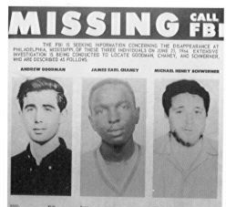
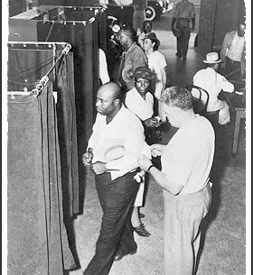
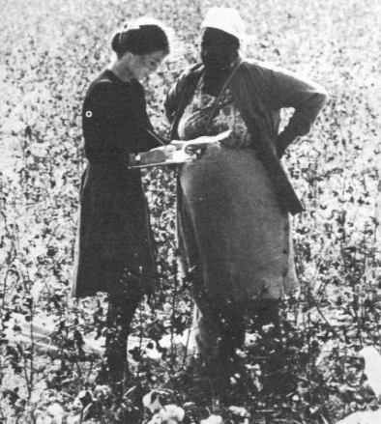
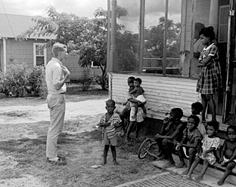
Freedom Summer, 1964
Civil rights leaders responded with new initiatives to bring voting rights
In 1964, white & black college students took part in Freedom Summer to help register African American voters in Mississippi
Freedom Summer volunteers faced resistance; 3 were murdered by KKK & local police
Notes:
In an effort to bring the issue of voting rights to national attention, Martin Luther King, Jr. launched a voter registration drive in Selma, Alabama, in early 1965. Even though blacks slightly outnumbered whites in the city of 29,500 people, Selma's voting rolls were 99 percent white and 1 percent black. For seven weeks, King led hundreds of Selma's black residents to the county courthouse to register to vote. Nearly 2,000 black demonstrators, including King, were jailed by County Sheriff James Clark for contempt of court, juvenile delinquency, and parading without a permit. After a federal court ordered Clark not to interfere with orderly registration, the sheriff forced black applicants to stand in line for up to five hours before being permitted to take a "literacy" test. Not a single black voter was added to the registration rolls.
When a young black man was murdered in nearby Marion, King responded by calling for a march from Selma to the state capitol of Montgomery, 50 miles away. On March 7, 1965, black voting-rights demonstrators prepared to march. "I can't promise you that it won't get you beaten," King told them, "... but we must stand up for what is right!" As they crossed a bridge spanning the Alabama River, 200 state police with tear gas, night sticks, and whips attacked them. The march resumed on March 21 with federal protection. The marchers chanted: "Segregation's got to fall ... you never can jail us all." On March 25 a crowd of 25,000 gathered at the state capitol to celebrate the march's completion. Martin Luther King, Jr. addressed the crowd and called for an end to segregated schools, poverty, and voting discrimination. "I know you are asking today, 'How long will it take?' ... How long? Not long, because no lie can live forever."
Within hours of the march's end, four Ku Klux Klan members shot and killed a 39-year-old white civil rights volunteer from Detroit named Viola Liuzzo. President Johnson expressed the nation's shock and anger. "Mrs. Liuzzo went to Alabama to serve the struggle for justice," the President said. "She was murdered by the enemies of justice who for decades have used the rope and the gun and the tar and the feather to terrorize their neighbors."
Two measures adopted in 1965 helped safeguard the voting rights of black Americans. On January 23, the states completed ratification of the 24th Amendment to the Constitution barring a poll tax in federal elections. At the time, five Southern states still had a poll tax. On August 6, President Johnson signed the Voting Rights Act, which prohibited literacy tests and sent federal examiners to seven Southern states to register black voters. Within a year, 450,000 Southern blacks registered to vote.

Slide 20
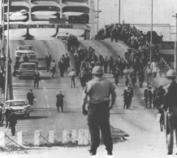
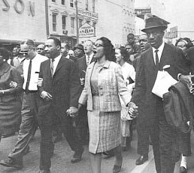
March in Selma, 1965
Civil rights leaders responded with new initiatives to bring voting rights
In 1965, MLK organized a march in Selma, Alabama to protest voting restrictions
Police violence at Selma convinced President Johnson to push for a new federal voting law
Notes:
In an effort to bring the issue of voting rights to national attention, Martin Luther King, Jr. launched a voter registration drive in Selma, Alabama, in early 1965. Even though blacks slightly outnumbered whites in the city of 29,500 people, Selma's voting rolls were 99 percent white and 1 percent black. For seven weeks, King led hundreds of Selma's black residents to the county courthouse to register to vote. Nearly 2,000 black demonstrators, including King, were jailed by County Sheriff James Clark for contempt of court, juvenile delinquency, and parading without a permit. After a federal court ordered Clark not to interfere with orderly registration, the sheriff forced black applicants to stand in line for up to five hours before being permitted to take a "literacy" test. Not a single black voter was added to the registration rolls.
When a young black man was murdered in nearby Marion, King responded by calling for a march from Selma to the state capitol of Montgomery, 50 miles away. On March 7, 1965, black voting-rights demonstrators prepared to march. "I can't promise you that it won't get you beaten," King told them, "... but we must stand up for what is right!" As they crossed a bridge spanning the Alabama River, 200 state police with tear gas, night sticks, and whips attacked them. The march resumed on March 21 with federal protection. The marchers chanted: "Segregation's got to fall ... you never can jail us all." On March 25 a crowd of 25,000 gathered at the state capitol to celebrate the march's completion. Martin Luther King, Jr. addressed the crowd and called for an end to segregated schools, poverty, and voting discrimination. "I know you are asking today, 'How long will it take?' ... How long? Not long, because no lie can live forever."
Within hours of the march's end, four Ku Klux Klan members shot and killed a 39-year-old white civil rights volunteer from Detroit named Viola Liuzzo. President Johnson expressed the nation's shock and anger. "Mrs. Liuzzo went to Alabama to serve the struggle for justice," the President said. "She was murdered by the enemies of justice who for decades have used the rope and the gun and the tar and the feather to terrorize their neighbors."
Two measures adopted in 1965 helped safeguard the voting rights of black Americans. On January 23, the states completed ratification of the 24th Amendment to the Constitution barring a poll tax in federal elections. At the time, five Southern states still had a poll tax. On August 6, President Johnson signed the Voting Rights Act, which prohibited literacy tests and sent federal examiners to seven Southern states to register black voters. Within a year, 450,000 Southern blacks registered to vote.

Slide 21
Civil Rights under LBJ
After the Selma march, LBJ signed the Voting Rights Act of 1965:
Banned literacy tests & sent federal voting officials into the South to protect voters
Voter registration & turnout increased among black citizens
African Americans elected black politicians for the 1st time since Reconstruction (1865-1877)
Notes:
The act finally accomplished what Republicans had envisioned with the 15th Amendment in 1870

Slide 23
Conclusions
The Civil Rights movement of the 1950s & 1960s finally brought an end to segregation
African Americans gained protection of their voting rights
The Civil Rights movement inspired other minority groups to demand equality

Slide 24
“I Have a Dream” Analysis
What was the impact of the Civil Rights movement in America?
Listen to MLK’s “I Have a Dream” speech & identify the major points
Examine the data provided: To what extent was MLK’s dream a reality by the end of the 1960s?
To what extent is MLK’s dream a reality today?

Slide 25
Essential Question:
What was the difference in the civil rights philosophies of Martin Luther King & Malcolm X?
CPUSH Agenda for Unit 13.2:
Clicker Questions
“MLK vs. Malcolm X” activity
Today’s HW: 28.1
Unit 13 Test: Tuesday, April 12
Bonus Points! Friday at 10:15 “Freedom Summer” video Room 407

Slide 26
Review Martin Luther King’s “Letter from a Birmingham Jail”

Slide 27
Competing Voices of Civil Rights: Martin Luther King, Jr. vs. Malcolm X
Who was Malcolm X?
Read background information, watch the Malcolm X video, answer the questions
Match the quotations with the appropriate author & complete the Venn diagram
Watch the video “Malcolm X on Martin Luther King” & prepare for a discussion

