Slide 1
The 1950s: The Affluent Society
The end of WWII led to an era of wealth & spending in the 1950s:
The war stimulated the economy & ended the Great Depression
High wages, service pay for soldiers, & war bond investments gave Americans money to spend
The economic boom allowed Americans to enjoy the highest standard of living in the world
Notes:
Most economists who had forecast a postwar depression were proved wrong because they had failed to consider consumers’ pent-up accumulation of needs and wants. People had gone without many goods for so long that by the late 1940s, with more than $135 billion in savings from defense work, service pay, and investments in war bonds, Americans suddenly had money to spend. They snatched up everything from automobiles to houses. After a brief period of postwar economic readjustment, the American economy boomed. The demand for goods and services outstripped the supply and increased production, which created new jobs. Judging from the graphs (shown left), many Americans prospered in the 1950s in what the economist John Kenneth Galbraith called “the affluent society.” The Cold War also contributed to economic growth. Concern over Soviet expansion kept American defense spending high and people employed. Foreign-aid programs, such as the Marshall Plan, provided another boost to the American economy. By helping nations in Western Europe recover from the war, the United States helped itself by creating strong foreign markets for its exports
After World War II ended, Americans turned their attention to their families and jobs. The economy prospered. New technologies and business ideas created fresh opportunities for many, and by the end of the decade Americans were enjoying the highest standard of living in the world. The American dream of a happy and successful life seemed within the reach of many people.

Slide 2
The 1950s: Consumerism
Consumerism returned in the 1950s
People rushed to buy new goods like TVs & hi-fi record players
Credit became available (The 1st credit card was created in 1950)
Advertisers used newspaper ads, radio, & new TV commercials to market goods to Americans
Franchises offered people across the country the same products
For the 1st time since the 1920s, Americans had access to cheap electrical appliances & cars
Notes:
Expansion of business in the 1950s:
Corporations, Franchises (848)
Consumerism (854-855)

Slide 3
The 1950s: The Baby Boom
Americans produced a “baby boom” in the 1950s, leading to the largest generation in U.S. history
The return of soldiers from war led to an increase in marriages & a rise in the birthrate
The baby boom led to a demand for new baby products, schools, & homes for growing families
Notes:
Returning soldiers, housing shortage, baby boom
Levittville
Suburban shopping centers
GI Bill of Rights (?)

Slide 4
The 1950s: Suburbs
Suburbs boomed in the 1950s:
The majority of Americans worked in cities but wanted the security of suburbs for their families
Suburbs offered peace of mind, affordable homes, & good schools
The GI Bill of Rights offered returning soldiers cheap loans for new homes & tuition for college
Notes:
Returning soldiers, housing shortage, baby boom
Levittville
Suburban shopping centers
GI Bill of Rights (?)

Slide 5
The 1950s: Suburbs
Suburbs changed American life:
Suburbs increased America’s need for cars & highways
Churches, schools, grocery stores, & shopping centers were build to service the suburbs
But, the migration to the suburbs was mostly by white families; “White flight” to the suburbs left African Americans in urban areas
Notes:
Returning soldiers, housing shortage, baby boom
Levittville
Suburban shopping centers
GI Bill of Rights (?)

Slide 6
The 1950s: Automania
In the 1950s, Americans bought cars in record numbers:
The growth of suburbs, creative advertising, easy credit, & cheap gasoline led to a car boom
Congress added 41,000 miles of expressway when the Interstate Highway Act was passed in 1956
Automobile companies made big, powerful, flashy cars

Slide 7
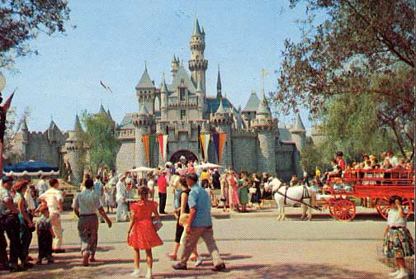
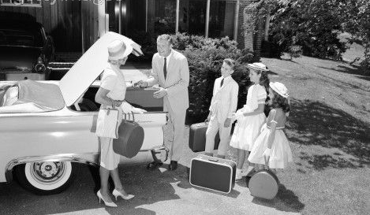
“Automania” transformed America
Americans were more mobile, took long-distance vacations, & lived further from their jobs

Slide 8
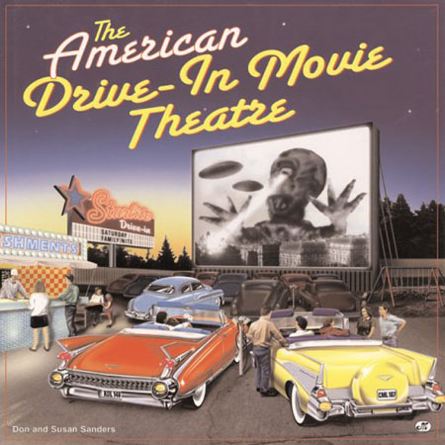
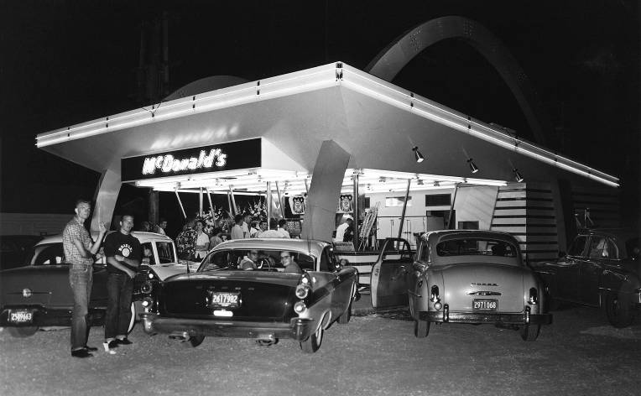
“Automania” transformed America
Cars led to drive-thru restaurants & drive-in movies

Slide 9
The 1950s: Popular Culture
Americans in the 1950s enjoyed new forms of entertainment:
Television boomed as Americans watched comedies, news reports, westerns, & variety shows
TV ownership jumped from 9% in 1950 to 90% by 1960 (45 million)
Businesses took advantage of TV to advertise goods to buyers

Slide 10
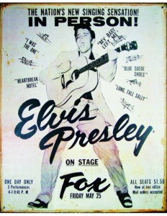
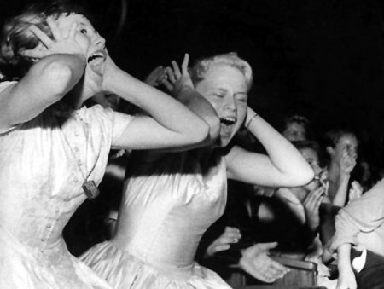
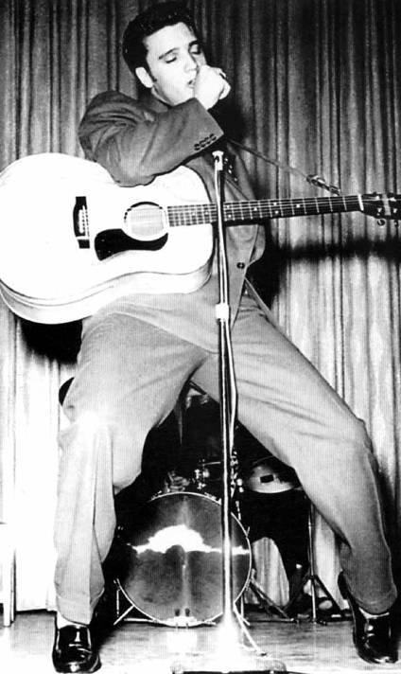
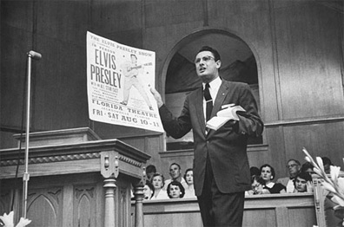
Rock scared parents who thought the fast beats were immoral
This rock ‘n’ roll music is a SIN!

Slide 11
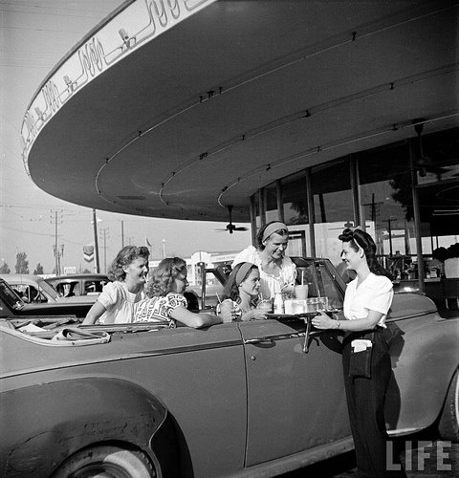
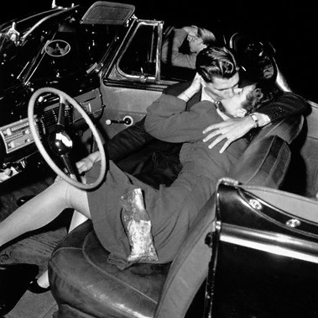
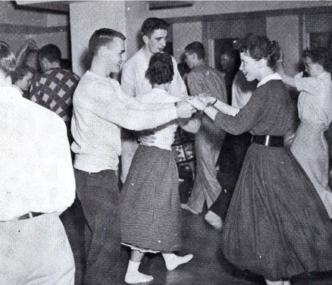
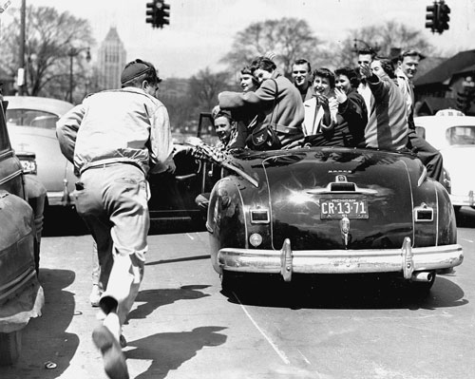
Teenagers were an important force in the 1950s
Suburban teens had leisure time & money to spend
Notes:
Businesses targeted teenagers, selling billions of dollars of “cool” consumer goods
Music & movies were made specifically for teens

Slide 12
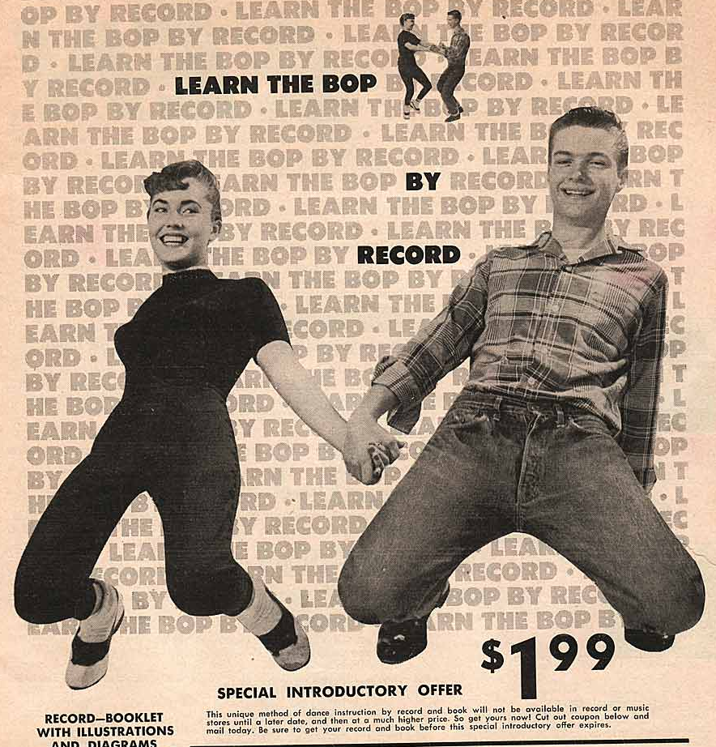
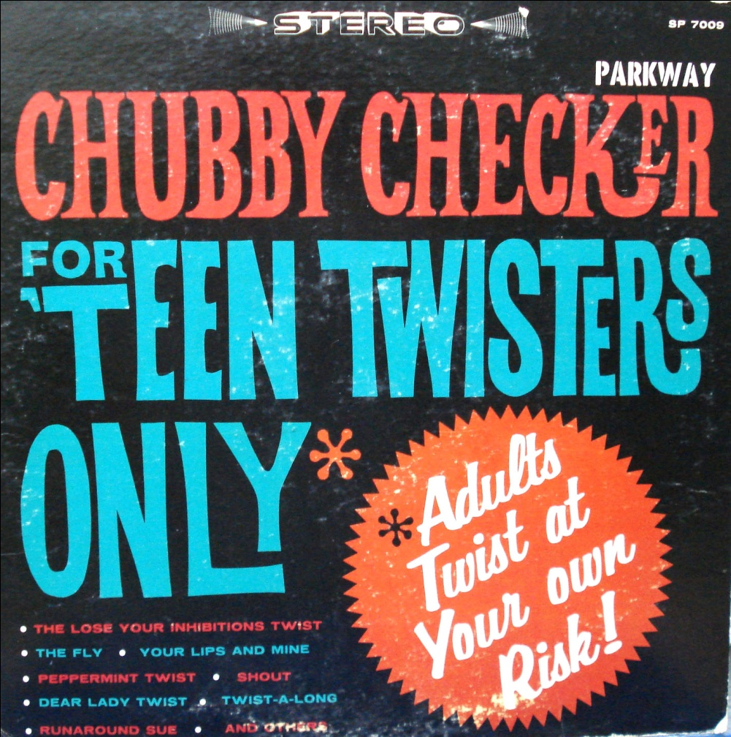
Teenagers were an important force in the 1950s
Businesses targeted teenagers, selling billions of dollars of “cool” consumer goods

Slide 13
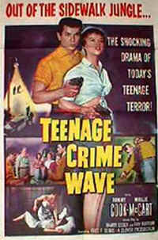
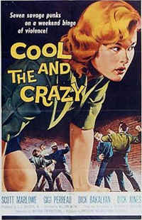
Hollywood movies targeted teens & made films about “juvenile delinquency”

Slide 14
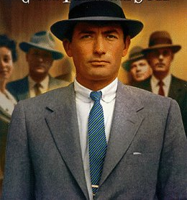
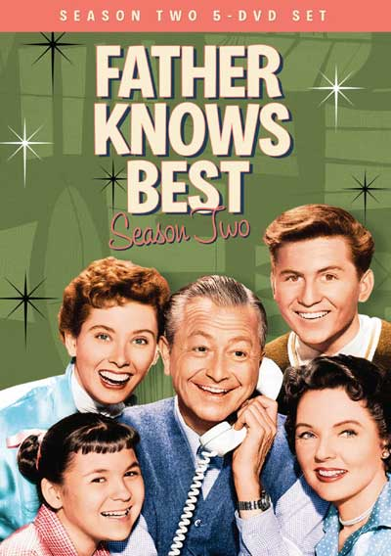
The 1950s: Conformity
TV, movies, & advertising in the 1950s promoted conformity & stereotypes
The “ideal man” was provider & boss of the house
Notes:
Ideal man? Ideal woman? Family expectations? Social expectations? Keeping up with the Joneses? White America?

Slide 15
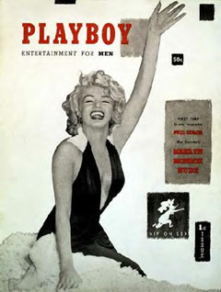
The 1950s: Conformity
TV, movies, & advertising in the 1950s promoted conformity & stereotypes
Changing Sexual Behavior:
Sexologist Alfred Kinsey revealed that:
Premarital sex was common
Extramarital affairs were frequent among married couples
Behavioral Rules of the 1950s:
Obey authority.
Control Your emotions.
Fit in with the crowd.
Don’t even think about sex!!!
But, stereotypes were not accurate of most Americans

Slide 16
The 1950s: Conformity
The “beat movement” rejected conformity:
“Beatniks” were artists & writers who lived non-conformist lives
Rejected suburbs, consumer goods, & “regular jobs”
Led by Jack Kerouac, the beats inspired the “hippies” of the 1960s
Notes:
Ideal man? Ideal woman? Family expectations? Social expectations? Keeping up with the Joneses? White America?

Slide 17
The 1950s: Social Groups
The 1950s had an important impact on women:
The media promoted women as mothers & homemakers, but almost 40% of mothers had jobs
20% of suburban women reported being dissatisfied, isolated, bored
Working women were limited to nursing, teaching, clerical jobs

Slide 18
The 1950s: Social Groups
African American civil rights leaders began to challenge segregation laws
In 1947, Jackie Robinson integrated professional baseball
In 1954, in Brown v Board of Education, the Supreme Court integrated public schools
In 1955, Martin Luther King, Jr. emerged as the leader of the civil rights movement

Slide 19
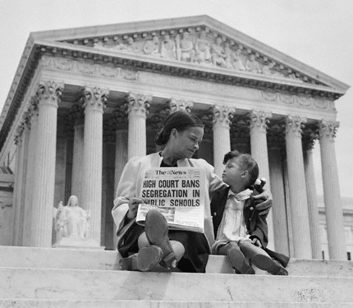
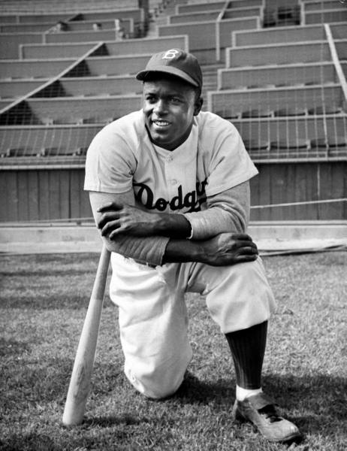
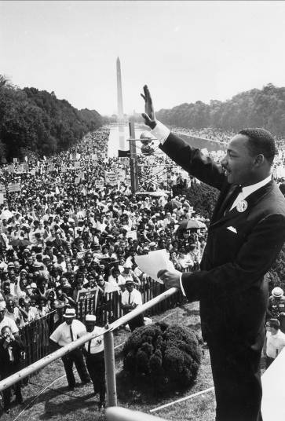
The Beginning of Civil Rights in the 1950s

Slide 20
Closure Activity
Create a chart in your notes that compares America in the 1950s to today
What are the biggest similarities between the 1950s & today?
What are the biggest differences?
1950s | Today

Slide 21
Closure Activity
1950s sensory figures:
Create a sketch a person in the 1950s
In the space surrounding your figure, describe the things that your character sees, hears, smells, feels, & thinks
Your sensory figures should include information about as many aspects of life in America during the 1950s (include both domestic & foreign affairs)

