Slide 1
Essential Question:
What role did the United States play in fighting in Europe during World War II?
Warm-Up Question:
Define each term:
Neutrality Acts, 1935-1937
Cash & Carry Program, 1939
Lend-Lease Program, 1941

Slide 2
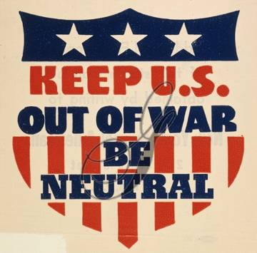
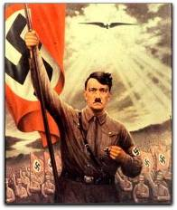
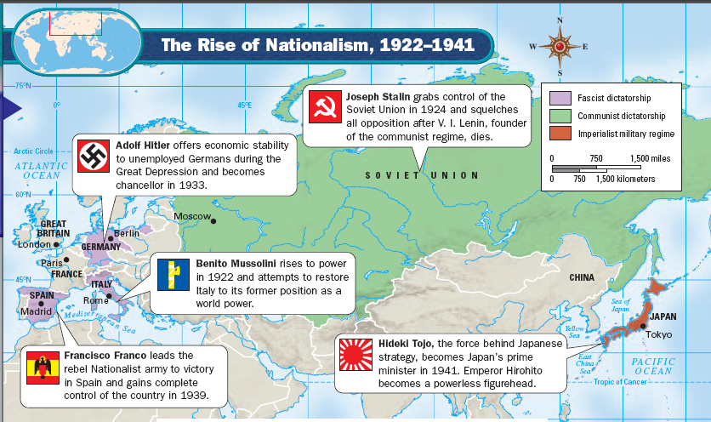
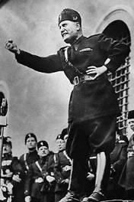
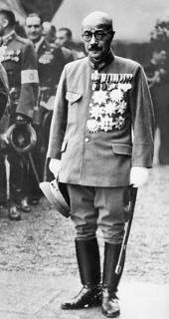
Quick World War 2 Review
Rise of Totalitarianism in Europe & Asia
U.S. Reaction: Neutrality Acts of 1935-1937

Slide 3
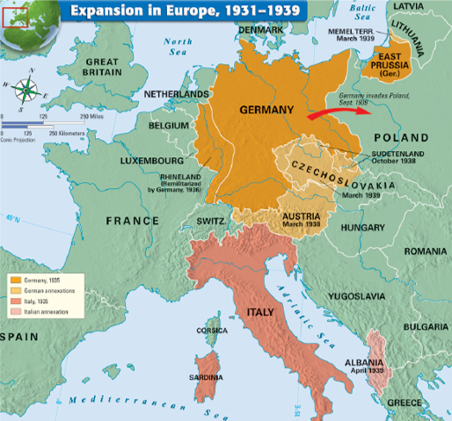
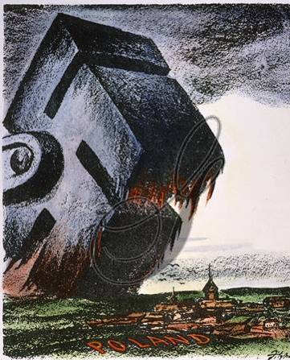
Quick World War 2 Review
German invasion of Poland & the outbreak of World War II in 1939
U.S. Reaction: Cash & Carry Program 1939

Slide 4
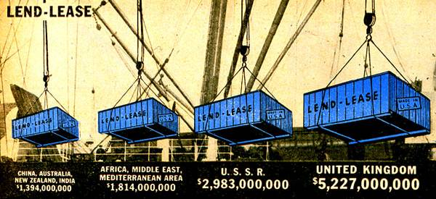
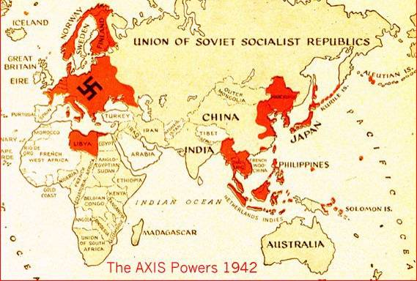
Quick World War 2 Review
Axis control of Europe & Asia in 1941; Battle of Britain; German invasion of USSR
U.S. Reaction: Lend-Lease Act, Atlantic Charter, Embargo of Japan

Slide 5
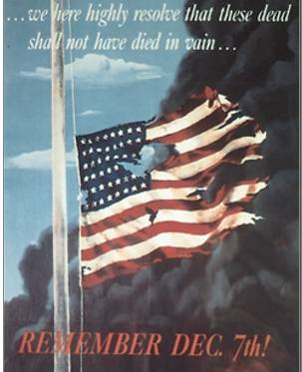
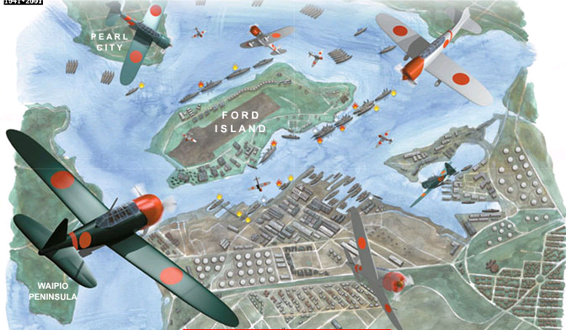
Quick World War 2 Review
Japanese attack on Pearl Harbor (December 7, 1941)
U.S. Reaction: Declaration of war & entry into WWII

Slide 6
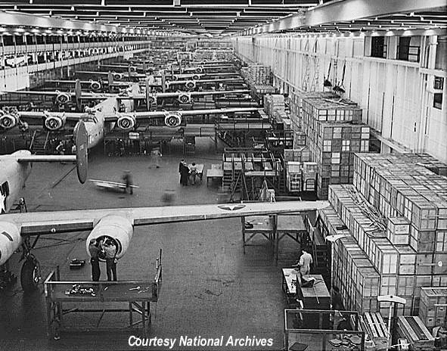
Quick World War 2 Review
Changes on the American Home Front
War Production Board directed U.S. industry
Office of Price Administration fixed priced & created ration books to save resources
Office of War Information directed press, print, radio, & film propaganda
Mobilization for war

Slide 7
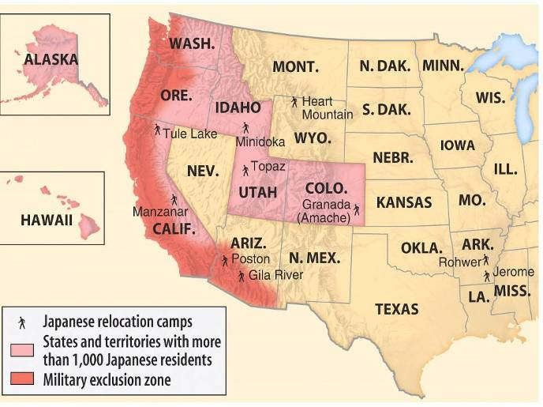
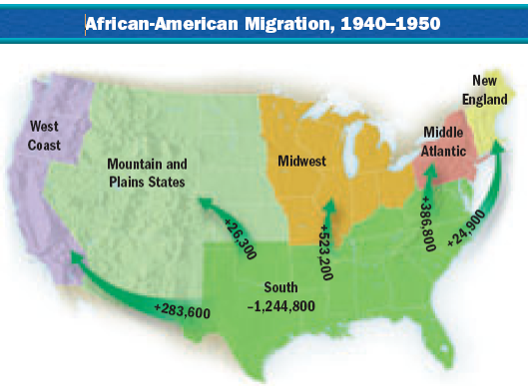
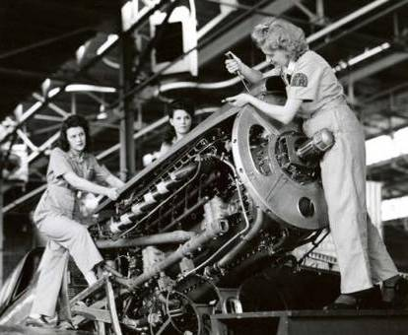
Quick World War 2 Review
Changes on the American Home Front
Impact on women, African Americans, Japanese Americans

Slide 8
World War 2 was a two “theater” war: Europe and the Pacific

Slide 9
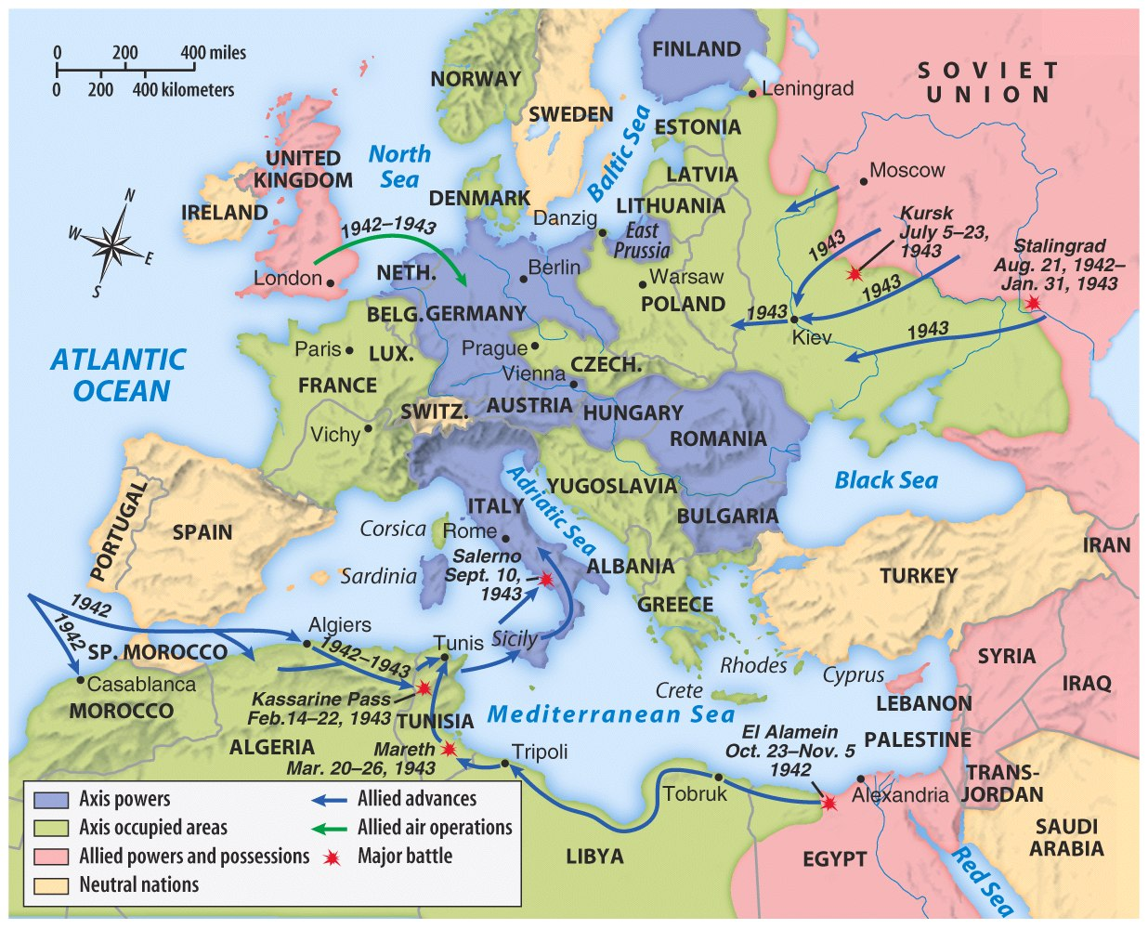
When the U.S. entered WW2 in late 1941, the Axis Powers were clearly winning the war
Germany controlled almost all of Europe
Germany pressed into the USSR
Axis armies controlled northern Africa & threatened the Suez Canal

Slide 10
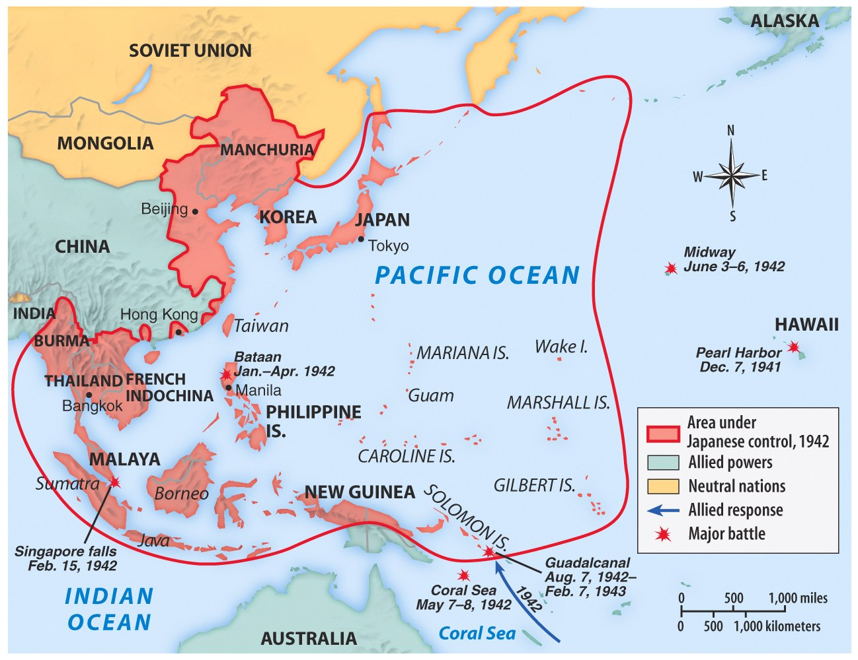
Japan dominated the western half of the Pacific Ocean

Slide 11
Fighting on the European Battlefront: U.S. Military Strategy in Early 1942
FDR and Churchill met for two weeks plotting their war strategy; the leaders agreed that defeating Hitler would be their top priority. Once Europe was freed, Allied forces could be redeployed to help the U.S. defeat Japan. The plan was set.
President Roosevelt knew that the first step towards victory in Europe was to secure the trans-Atlantic supply lines.
Notes:
Insert 5a & 5b videos

Slide 12
Fighting on the European Battlefront: U.S. Military Strategy in Early 1942
A major breakthrough came when the British cracked Germany’s coded communications. As a result, the Battle of the Atlantic swung in favor of the Allies and the German U-boat threat was neutralized.

Slide 13
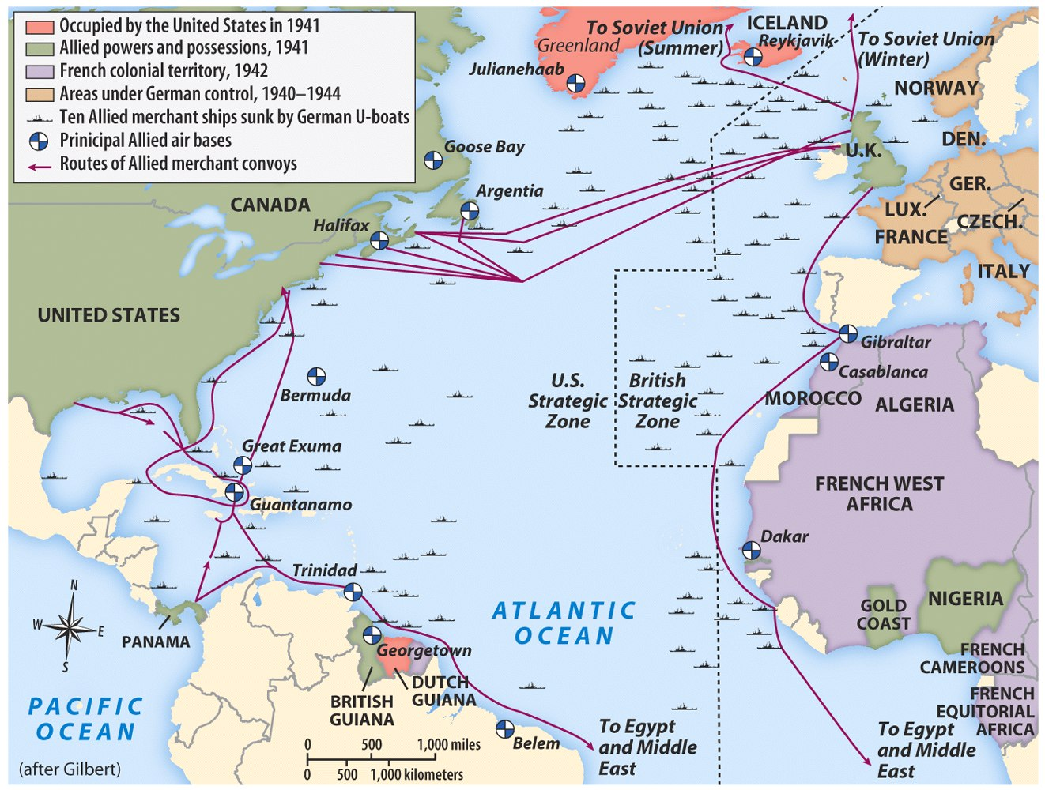
The Battle of the Atlantic, 1942

Slide 14
Fighting on the European Battlefront: Fighting in Europe, 1942-1943
The Allies’ first land offensive came in November 1942. U.S. General Dwight Eisenhower led 107,000 Allied troops ashore in Morocco and Algeria in North Africa. The Allies prevailed and the Germans were forced to retreat.
While the U.S. and Britain (the “Western Allies”) were fighting in North Africa, the Soviet Red Army refused to surrender the city of Stalingrad. After the battle, the victorious Soviet army began a steady march westward towards Germany.

Slide 15
Fighting on the European Battlefront: Fighting in Europe, 1942-1943
By the summer of 1943, Allied war planes were bombing German cities. Most attacks were aimed at military and industrial targets, but increasingly Allied air forces target civilian centers for so called “terror bombing” designed to demoralize the German public.
In July 1943, Allied troops invaded Italy in Operation Husky. By April 1945, Axis forces were removed from Italy and Italian dictator Benito Mussolini was captured and executed.

Slide 16
Europe 1942-1943

Slide 17
Fighting on the European Battlefront: Winning the War in Europe, 1944-1945
While the Soviet army marched through Poland and the Allies pushed north through Italy, Allied leaders finalized plans for the invasion of Nazi-occupied France and the liberation of western Europe. The mission was codenamed Operation Overlord, but history would remember it as “D-Day” (June 6, 1944). It was the largest military operation ever mounted.
Within a month, there were 1 million Allied troops on the continent fighting their way across France. By September 1944, France, Belgium, Luxemburg, and the Netherlands were freed from Nazi control while the Soviet army closed in on Germany from the East.

Slide 18
Fighting on the European Battlefront: Winning the War in Europe, 1944-1945
The Allies were pushed back at the Battle of the Bulge (outside Auchen, Germany), but in the end the German army was forced to retreat. It would be their last offensive. Hitler’s dream of a thousand year Reich was crumbling.
On April 23, the Soviet army stormed the German capital of Berlin In the face of defeat, Adolf Hitler took his own life rather than surrender. On May 7, 1945, the German High Command surrendered to Allied leaders. The long war in Europe was over.

Slide 19
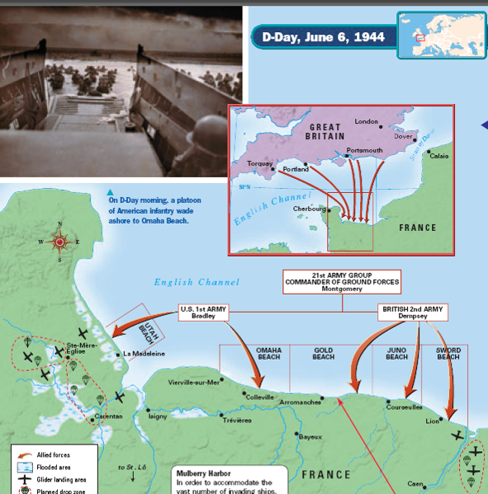
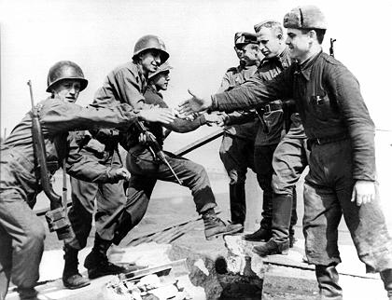
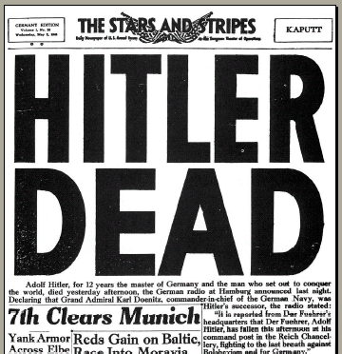
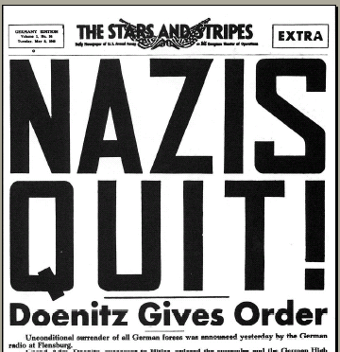
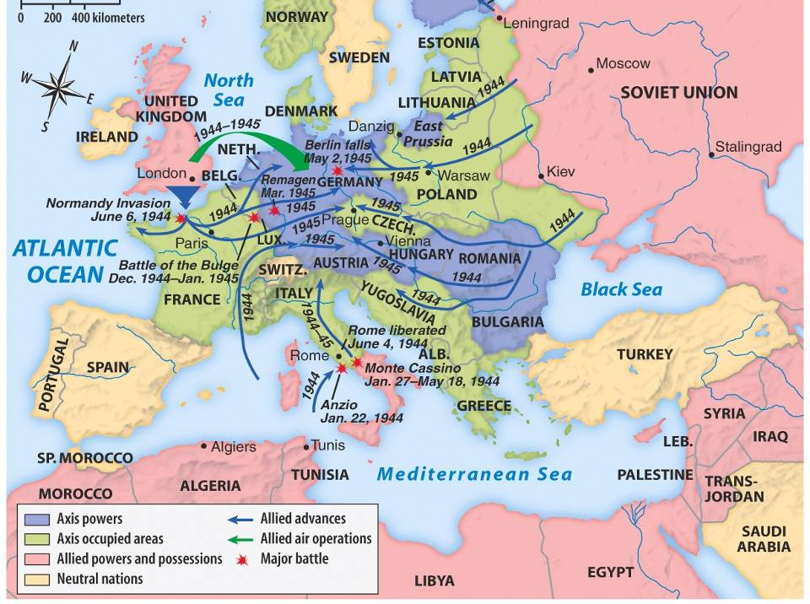
Europe 1944-1945

Slide 20
Fighting on the European Battlefront: Winning the War in Europe, 1944-1945
But with Germany defeated Allied troops came face-to-face with evidence of Nazi atrocities… concentration camps housing thousands of living corpses. History would reveal the true horrors of the Holocaust.

Slide 21
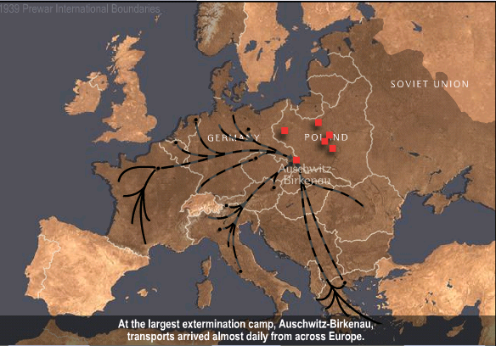
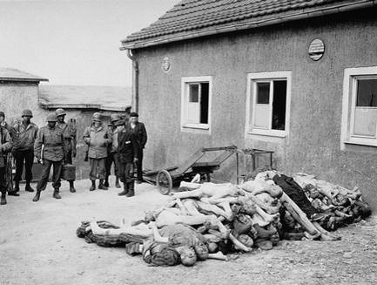
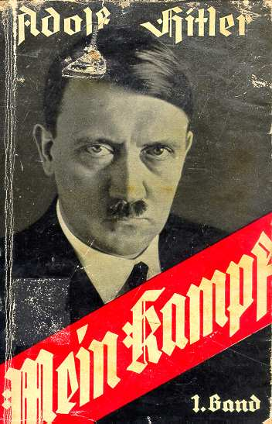
Play “Last Days” (begin at 49.26)

Slide 22
The United States & the Holocaust
Examine the timeline “Stages of the Holocaust” & read “Response to the Holocaust from the United States”
With a partner, answer the 3 discussion questions provided & prepare for a class discussion

