Slide 1
Analyzing Art Is a picture worth 1,000 words?

Slide 3
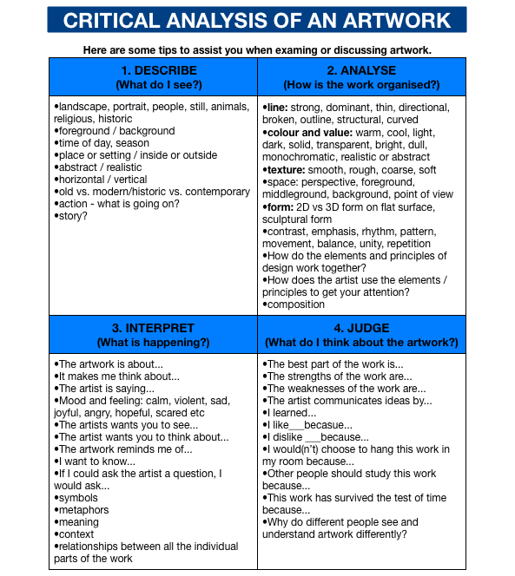

Slide 4
Cave of Bulls (France, c.15,000BCE)

Slide 5
Stonehenge (England, c. 3000BCE)

Slide 6
Mask of King Tut
Funeral Mask of King Tutankhamun (Egypt, 1323BCE)

